Slide 1
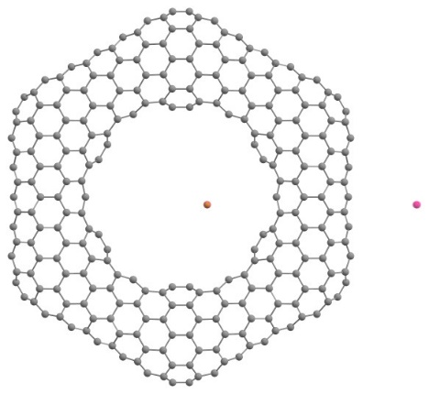
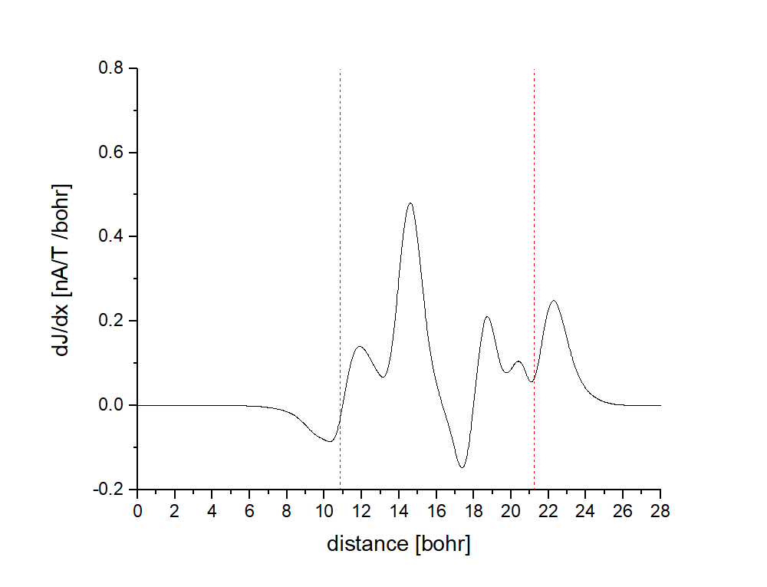
Latest developments in the module MPSHIFT and
magnetically induced ring currents in toroidal carbon nanotubes
Kevin Reiter

Slide 2

Overview
Latest developments in the module MPSHIFT – a summary
Theory
Chemical Shieldings with Effective Core Potentials
Environmental effects with COSMO
(MA)RI-J Approximation and further efficiency improvements
My work in Helsinki (13.11.2017 – 22.12.2017)
GIMIC calculations – Theory and application
[Hg₈Te₈(Te₂)₄]^{8–}: A Porphyrin analogon?
Ring current calculations on toroidal carbon nanotubes

Slide 3
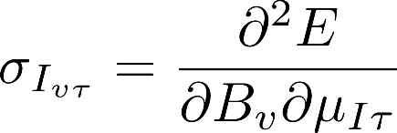
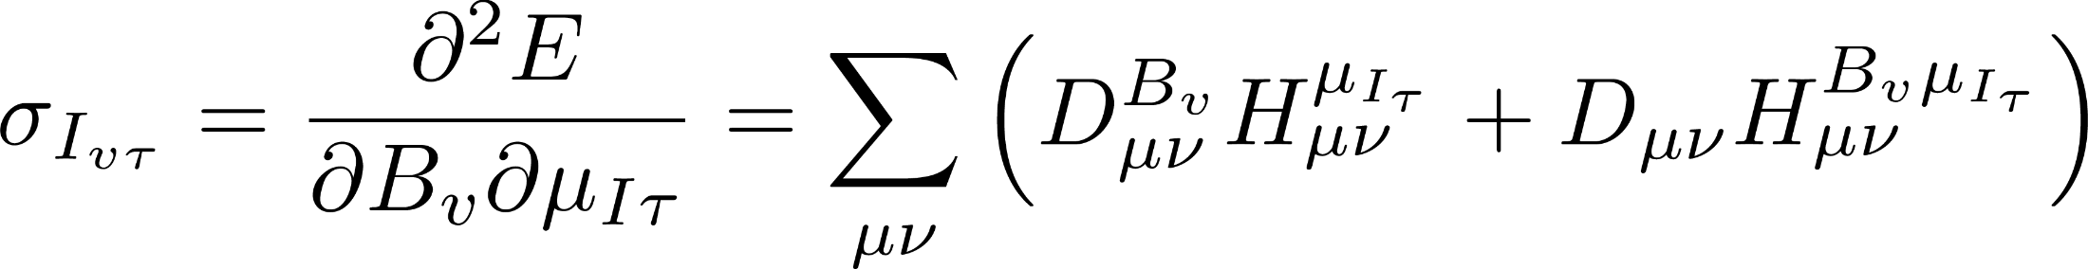
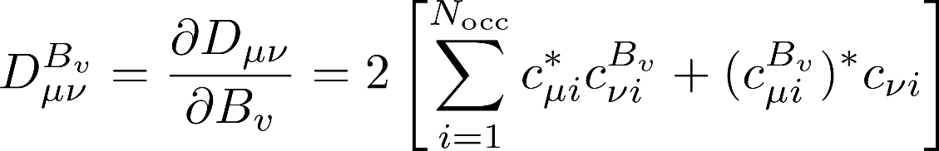
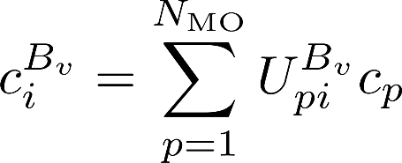
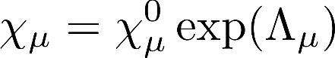
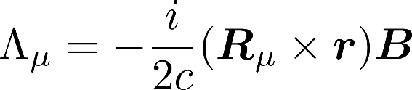
Theory
Chemical shielding tensor σ_{I} of a nucleus I
Requires calculation of integral derivatives wrt B and response of the wave function to the latter
Perturbed density matrix
Gauge including atomic orbitals (GIAOs)

Slide 4
Chemical shieldings with Effective Core Potentials
Derivative of V^{ECP} with respect to x-component of B
Expanding the integral in the first term
First integral standard ECP integral
Second integral: z-component of the angular moment for basis function is raised by one can be evaluated from standard ECP gradient integrals
K. Reiter, M.Kühn and F. Weigend, J. Chem. Phys. 146, 054102 (2017).

Slide 5
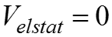
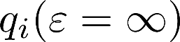
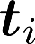
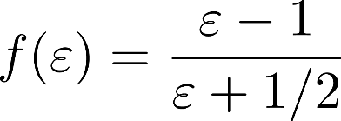
Environmental / solvent effects
COnductor-like Screening Model (COSMO):
Simulation of environmental / solvent effects by specification of on a shell around the molecule
→ response is described by generation of screening charges
screening charges: on segments at position finite permittivity of real solvents → scaling by factor
, with

Slide 6
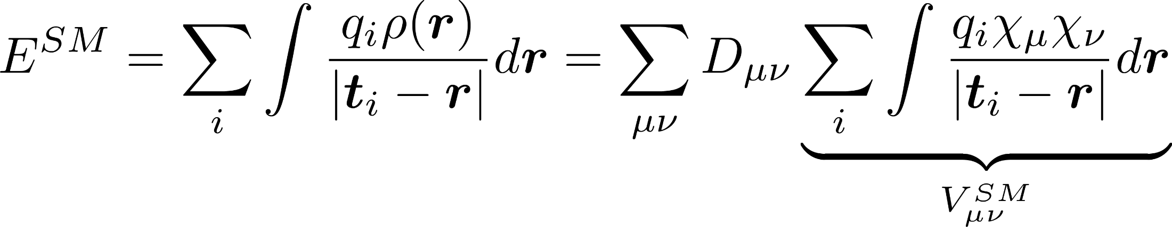
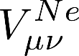
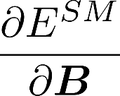
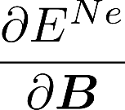
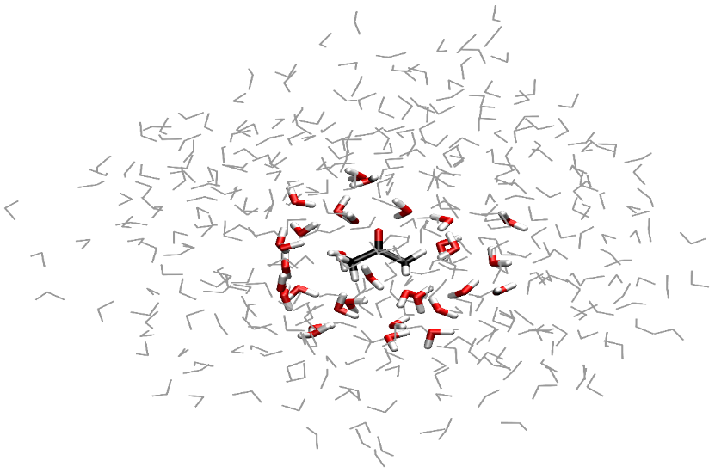
Environmental / solvent effects
Interaction energy: → same form as
can be calculated with the same routines needed for
COSMO
Exp.
Exp.
Point charges
Gaussian
smeared charges
16 H
O + PC
2
16 H
O
2
32 H
O
2
64 H
O
2
40
60
80
100
120
140
-25
-20
-15
-10
-5
σ
σ
σ
σ
(
O
)-
(
O
)
/ ppm
(
C
=O)-
(
gas phase
C
=O)
gas phase
/ ppm

Slide 7
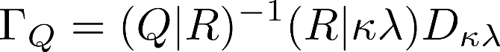
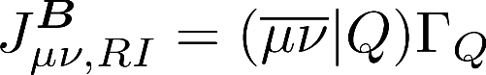
Efficiency - RI-J approximation
Derivative of the Coulomb part wrt the magnetic field
involves the derivative of two-electron-four-center integrals
Introduction of the RI-approximation for the first term

Slide 8
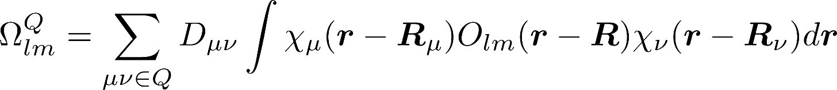
Efficiency - MARI-J approximation
Multipole accelerated resolution of the identity approximation: MARI-J Coulomb term is divided in a near-field (NF) and far-field (FF) part
NF part is evaluated by the RI-J approximation
FF part: Multipole approximation
Employment of gauge-including functions instead of usual ones is the only modification to be made
Derivative wrt the magentic field

Slide 9
Efficiency – further improvements
Efficient integral screening for Hartree-Fock exchange
linear-scaling DFT routines (including meta-GGA-functionals)
moderate parallelization
calculations of chemical shieldings for large systems feasible within 1(2) days with meta-GGA(-hybrid) functionals
Example 128 α-D-Glucose units
(2691 atoms or 23 699 Cartesian basis functions)
TPSS: 18.10 h
TPSSh: 42.99 h
K. Reiter, F.Mack and F. Weigend,
J. Chem. Theory Comput. 14, 191 (2018).

Slide 10
Implementation - summary
heavy elements (Z>36): relativistic core potentials
environmental / solvent effects: COSMO-Model + point charge model, + Gaussian smeared charge model
efficiency: RI-J approximation + multipole-accelerated RI-J (MARI-J) approximation + efficient integral screening for Hartree-Fock exchange + linear-scaling DFT routines (+ meta-GGA-functionals) + moderate parallelization
(Vibrational Circular Dichroism (VCD) spectra)
These implementations made the following MPSHIFT and GIMIC
calculations possible

Slide 11
GIMIC calculations

Slide 12
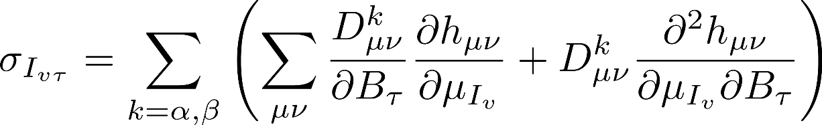
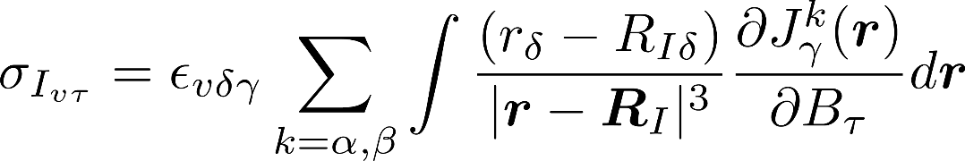
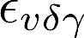
GIMIC calculations
GIMIC: Gauge-Including Magnetically Induced Currents
Corresponding Biot-Savart expression:
: Levi-Civita permutation tensor
Sundholm, D.; Fliegl, H.; Berger, R. J. Calculations of magnetically induced current densities: theory and applications.
WIREs Comput. Mol. Sci. 2016.

Slide 13
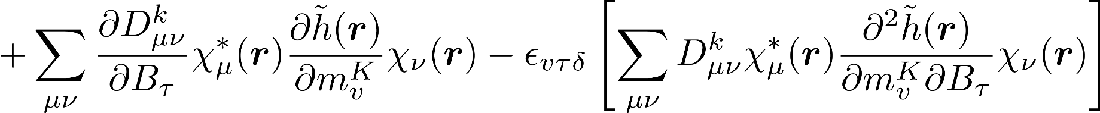
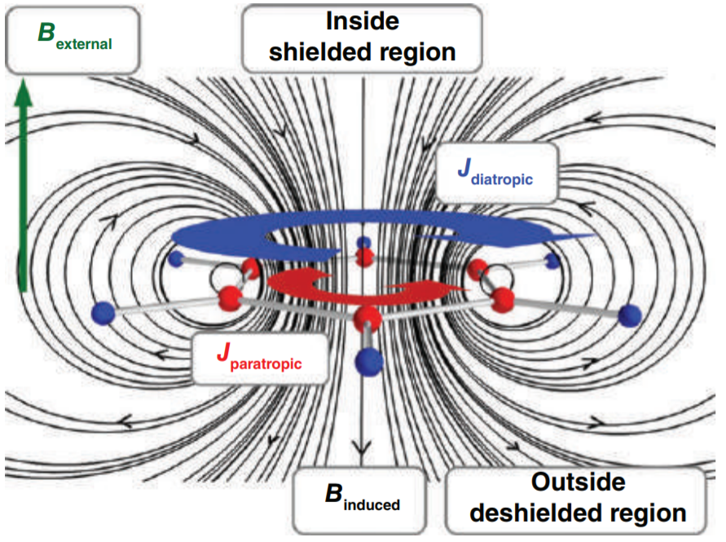
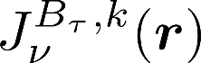
GIMIC calculations
Combining the last two equations yields the GIMIC equations
: first order magnetically induced
current density
Sundholm, D.; Fliegl, H.; Berger, R. J. Calculations of magnetically induced current densities: theory and applications. WIREs Comput. Mol. Sci. 2016.

Slide 14
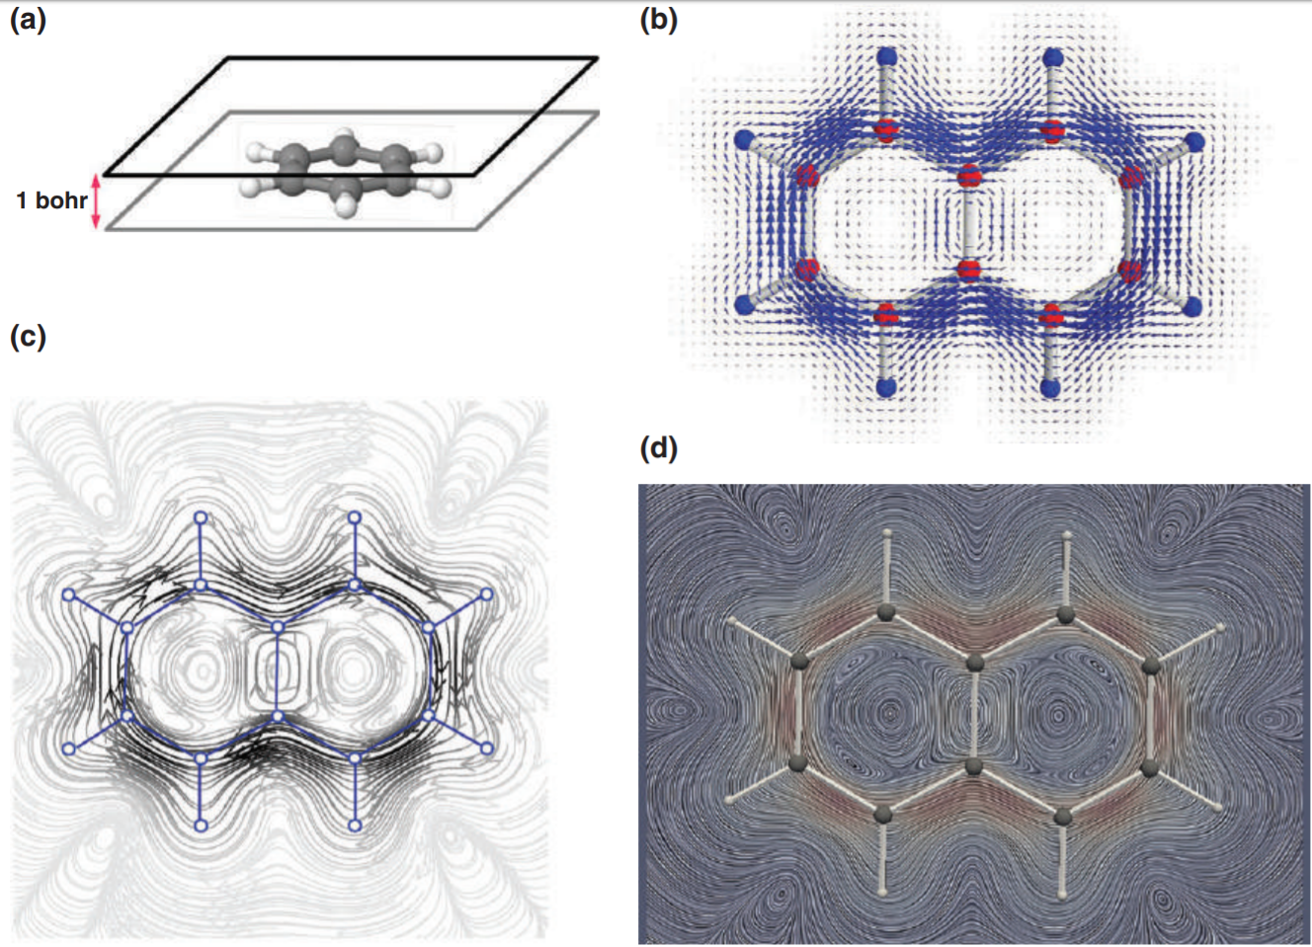
Visualization of the current density
Sundholm, D.; Fliegl, H.; Berger, R. J. Calculations of magnetically induced current densities: theory and applications.
WIREs Comput. Mol. Sci. 2016.

Slide 15
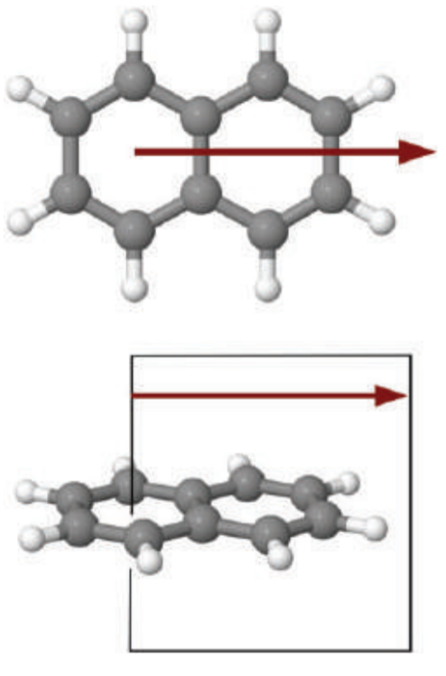
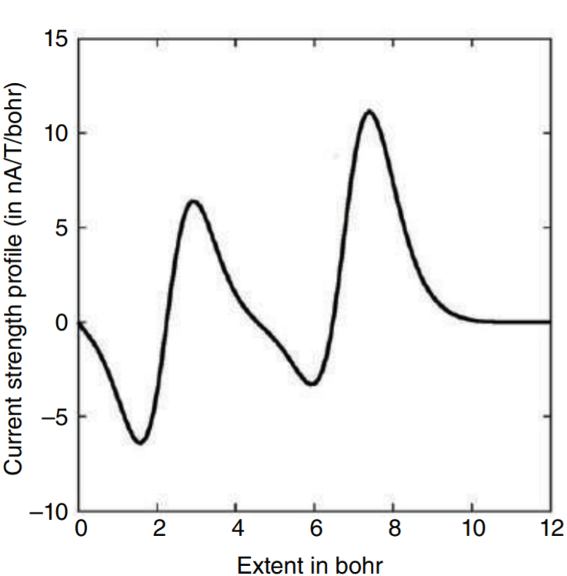
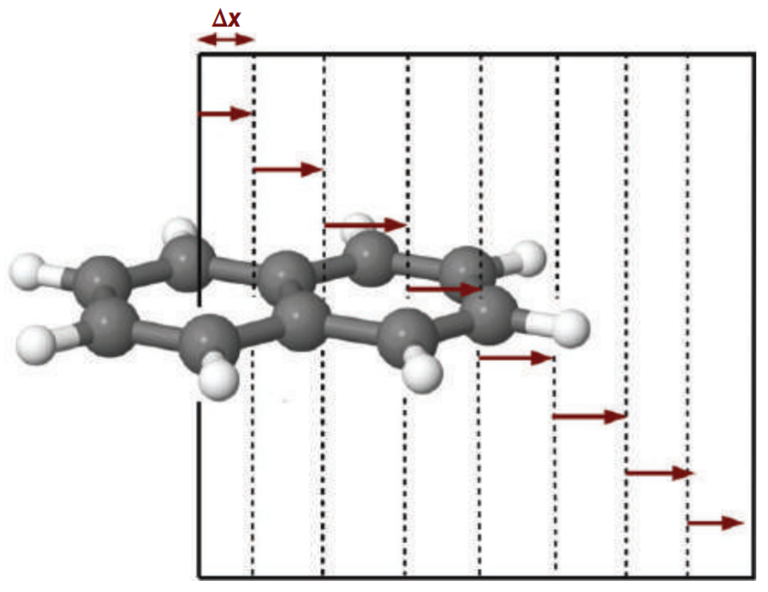
Integration of the current density
Sundholm, D.; Fliegl, H.; Berger, R. J. Calculations of magnetically induced current densities: theory and applications.
WIREs Comput. Mol. Sci. 2016.

Slide 16
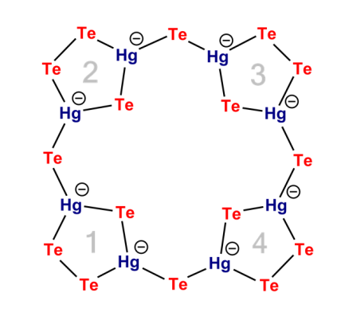
Application: [Hg₈Te₈(Te₂)₄]^{8–}
[Hg₈Te₈(Te₂)₄]^{8–}: A Porphyrin analogon?
Looks like Porphyin (synthesis: Dehnen, Marburg)
…but is electronically very different:
Ring currents based on magentic response calculated with TURBOMOLE (feasible
with the newly implented functionalities ECPs, COSMO, meta-GGA-DFT, RI-J)
[Hg₈Te₈(Te₂)₄]^{8–}:
(weak) local
ring currents
-> non-aromatic
Porphyrin:
(strong) global
ring currents
-> aromatic
C. Donsbach, K. Reiter, D. Sundholm, F. Weigend, S. Dehnen, submitted.

Slide 17
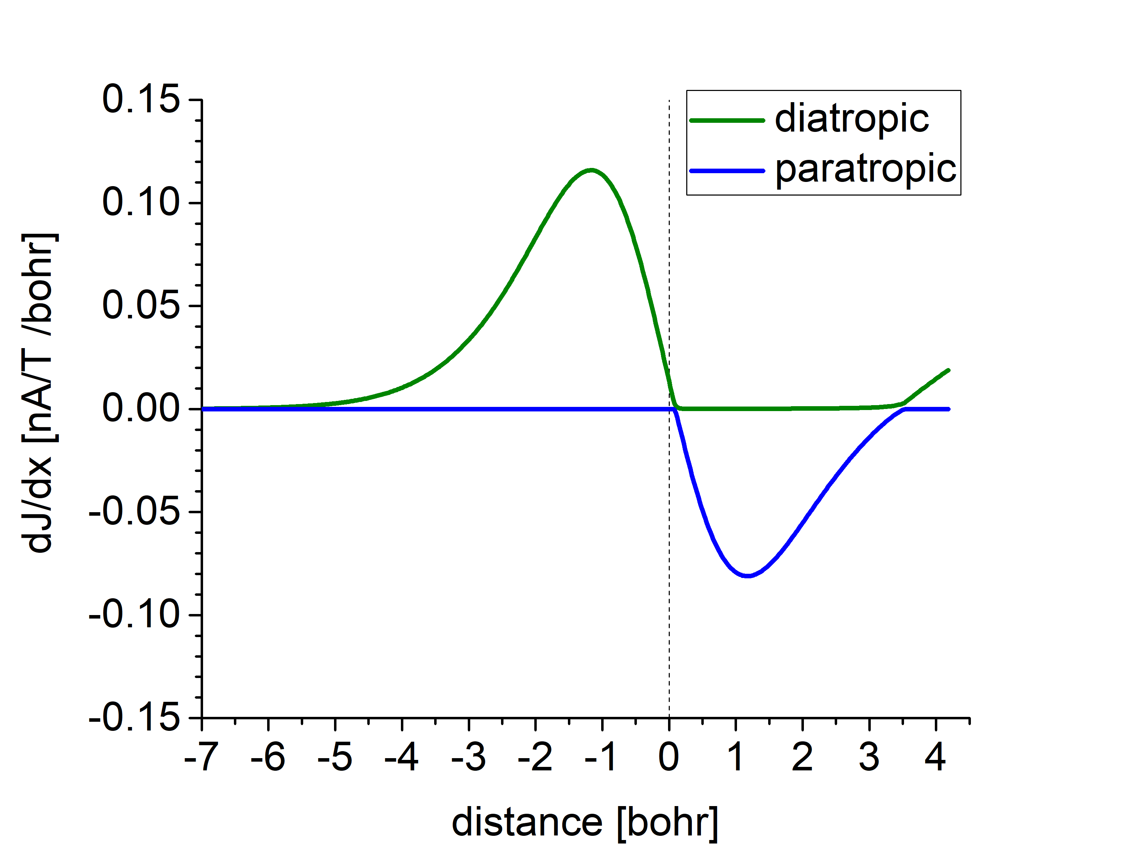
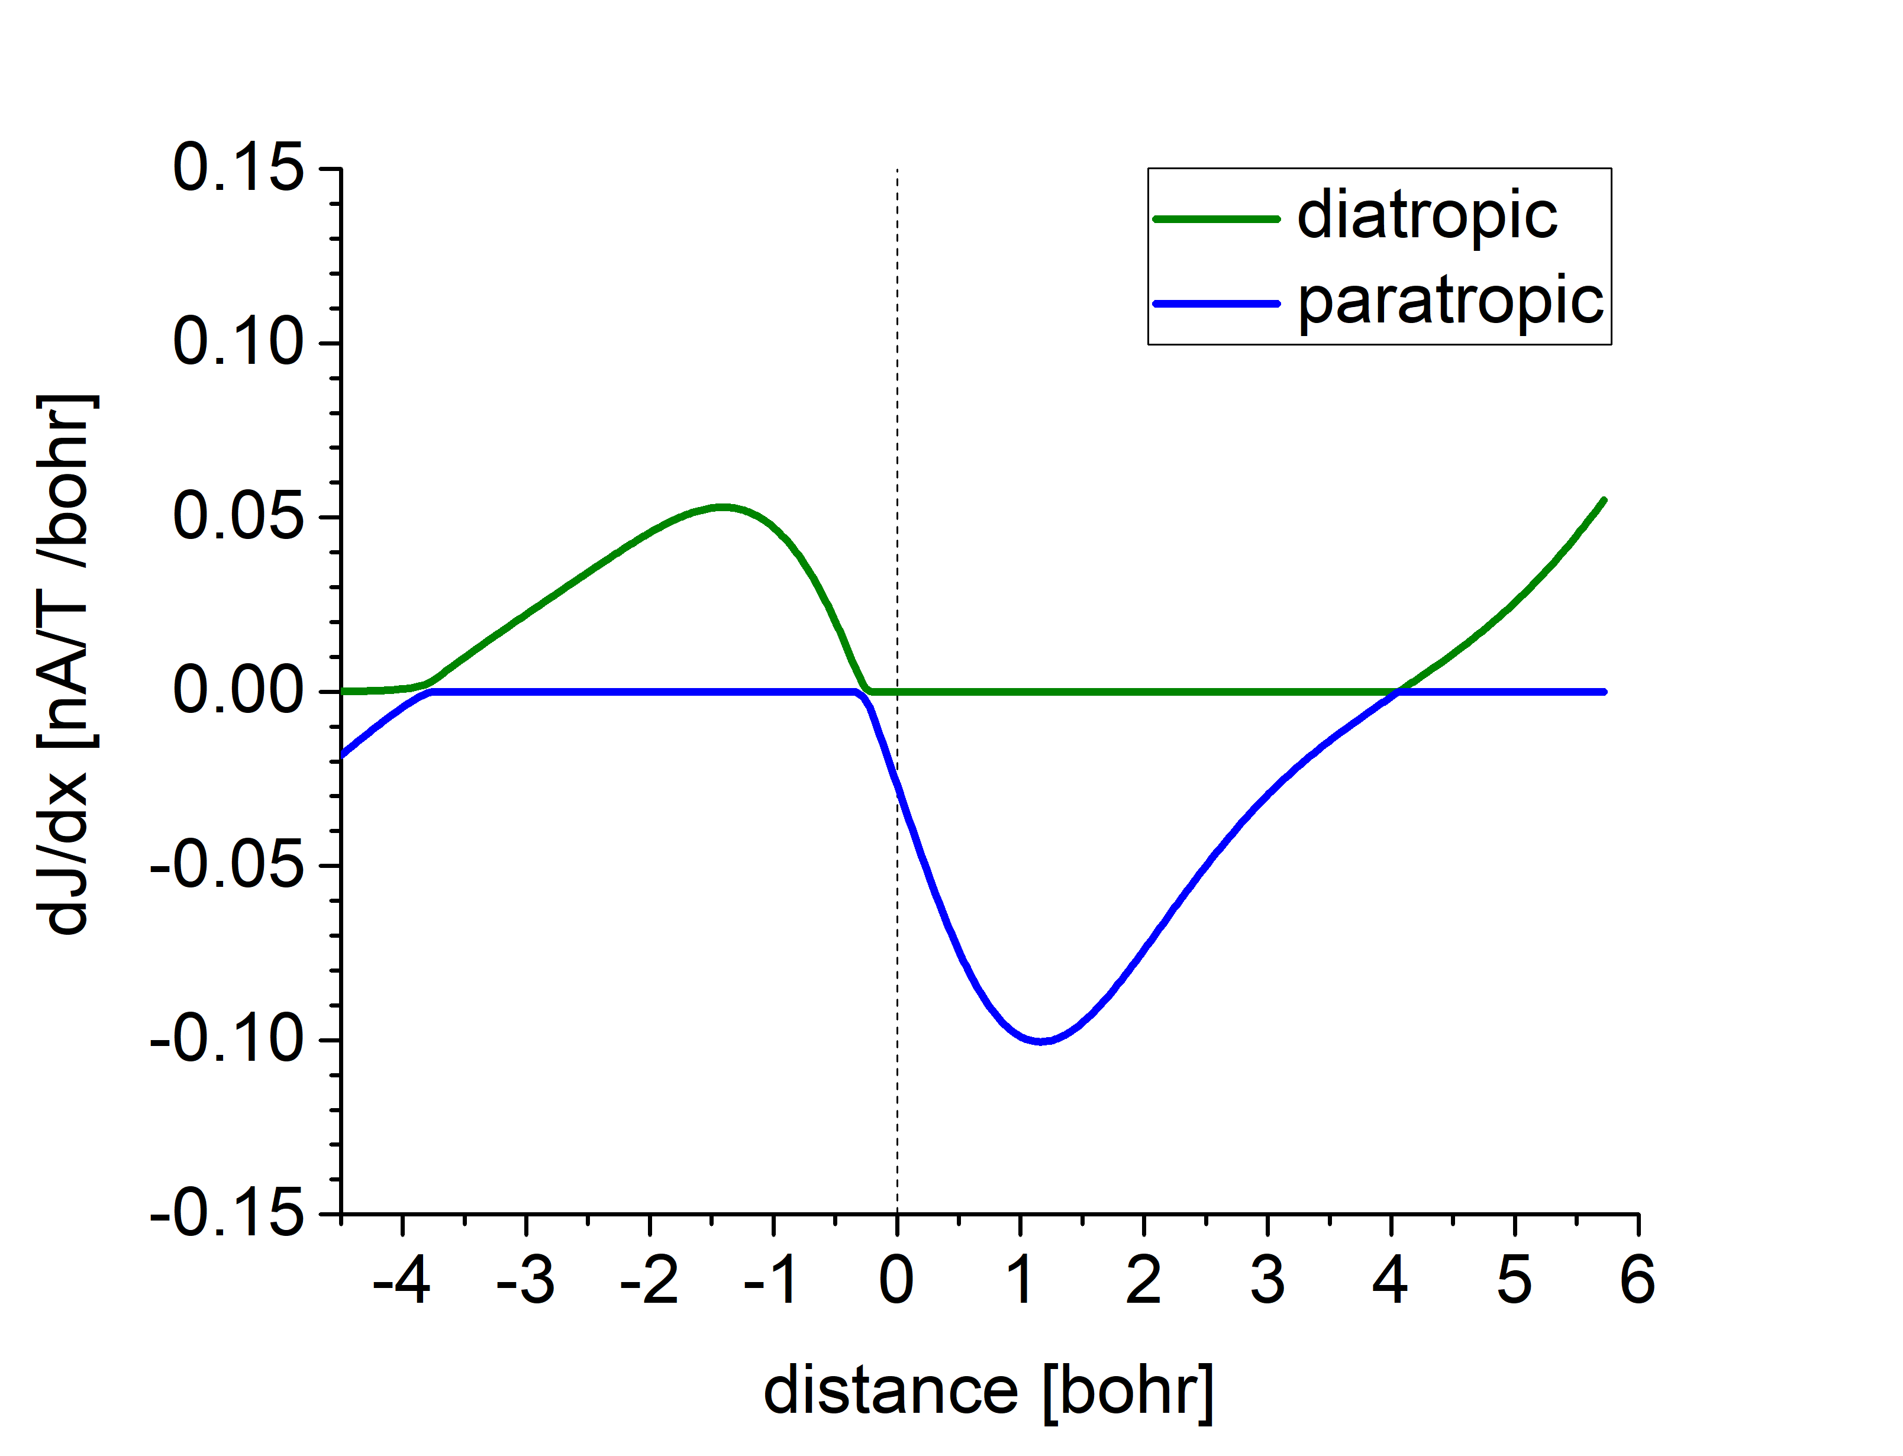
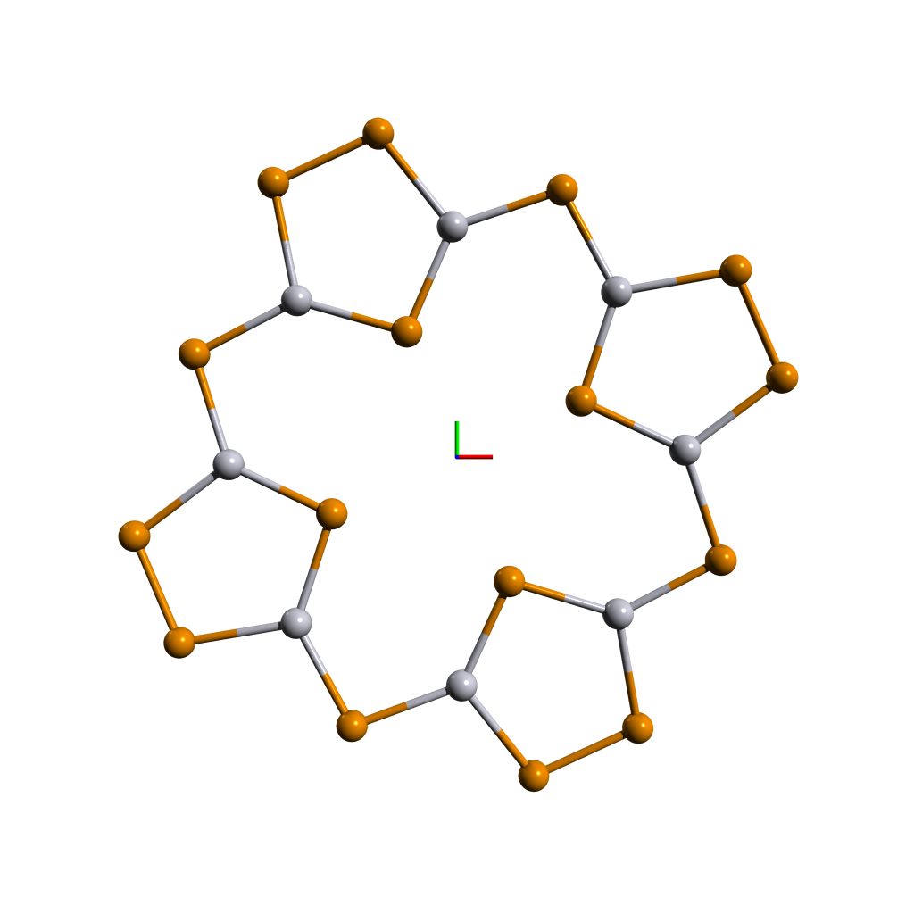
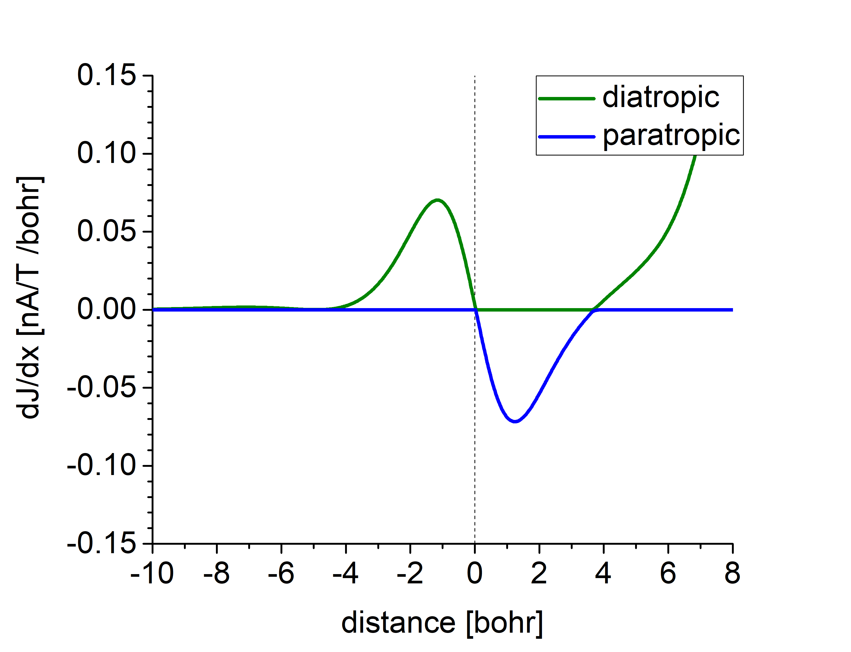
Application: [Hg₈Te₈(Te₂)₄]^{8–}
Bond 1-2
Bond 3-4
5.58
2
1
0.24
3
5
5.82
Bond 3-5
4

Slide 18
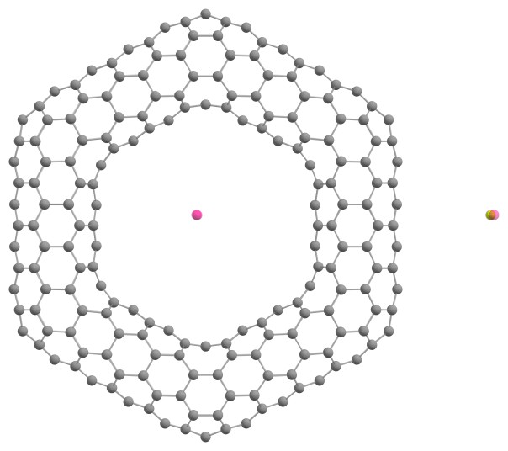
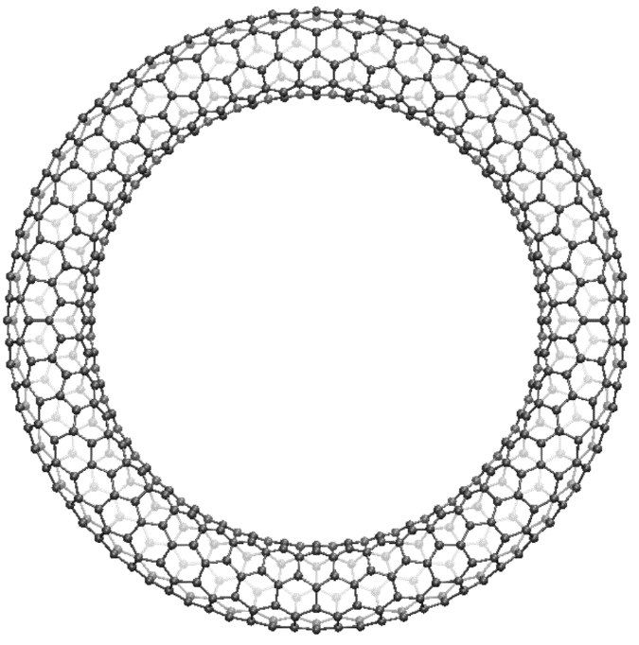
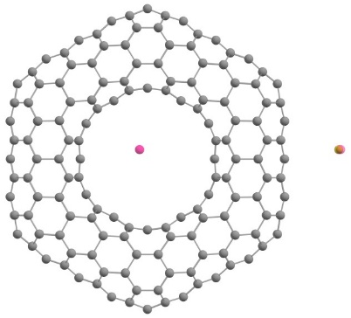
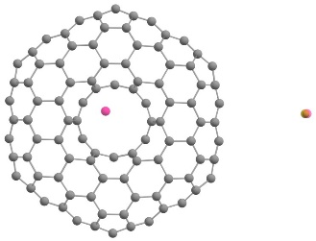
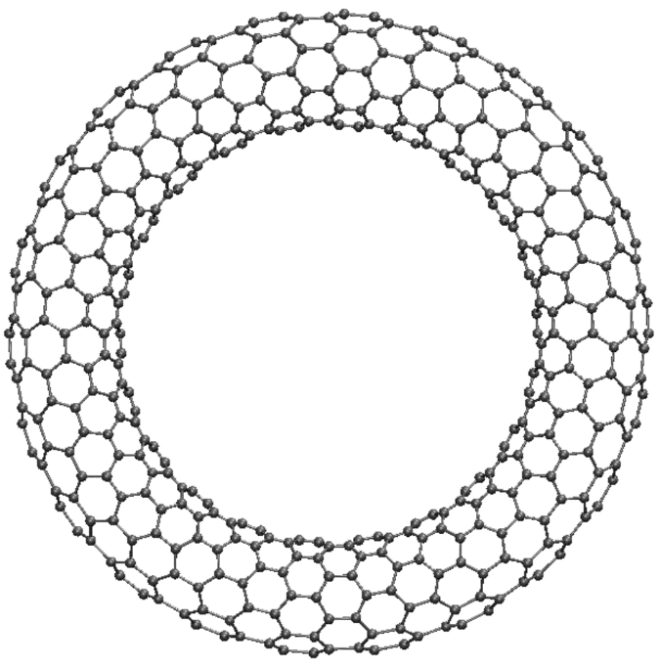
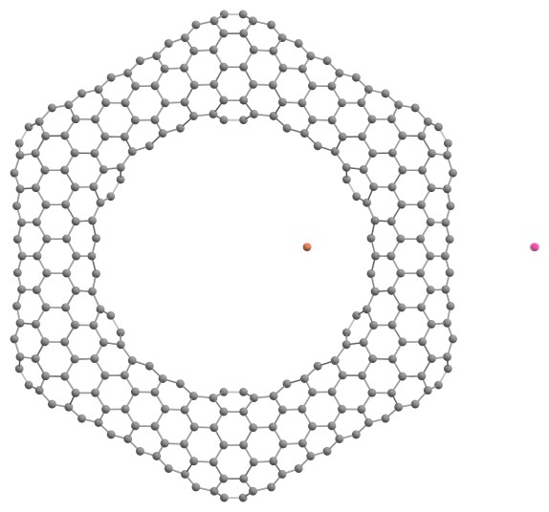
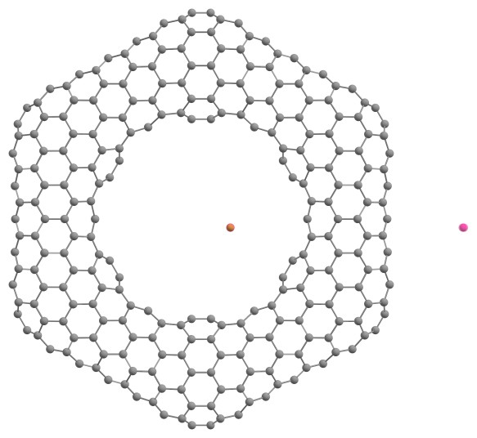
Toroidal Carbon Nanotubes (TCNT)

Slide 19
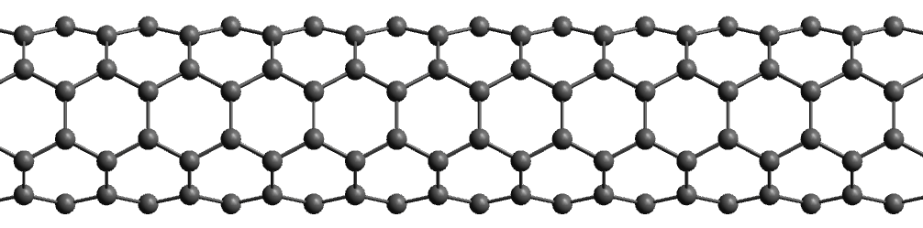
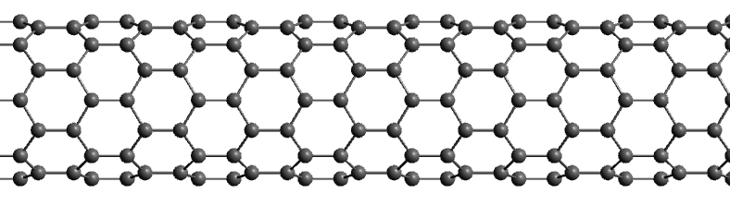
Carbon Nanotubes (CNT) - chirality
(n=4,m=4)-CNT: armchair
(n=8,m=0)-CNT: zigzag

Slide 20
Carbon Nanotubes (CNT) - chirality
(n=4,m=4)-CNT: armchair
(n=8,m=0)-CNT: zigzag
Toroidal Carbon Nanotubes (TCNT)
with pure hexagon networks

Slide 21
Toroidal Carbon Nanotubes
for small rings: inner bonds to short, outer bonds to long
optimization of structure parameters leads to elliptical tube cross-sections
TCNT with hexagons only become thermodynamically stable for diameters of ~ 200 nm
First investigated structures (mainly chiral TCNT) showed no net current at all
Introduction of pentagons and heptagons reduces stress in the system

Slide 22
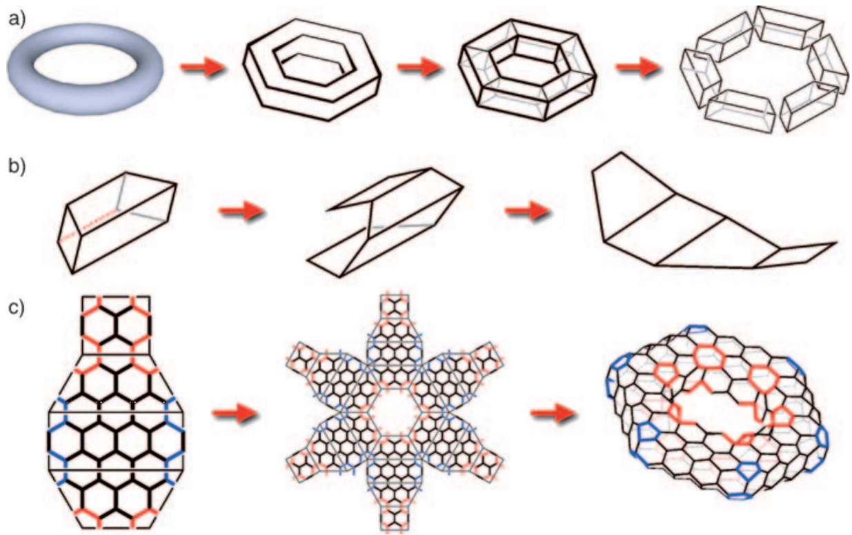
TCNT with pentagons and heptagons
Beuerle, F.; Herrmann, C.; Whalley, A. C.; Valente, C.; Gamburd, A.; Ratner, M. A.; Stoddart, J. F. Chem. Eur. J. 2011, 17, 3868.

Slide 23
TCNT with pentagons and heptagons
Beuerle, F.; Herrmann, C.; Whalley, A. C.; Valente, C.; Gamburd, A.; Ratner, M. A.; Stoddart, J. F. Chem. Eur. J. 2011, 17, 3868.

Slide 24
TCNT with pentagons and heptagons
Beuerle, F.; Herrmann, C.; Whalley, A. C.; Valente, C.; Gamburd, A.; Ratner, M. A.; Stoddart, J. F. Chem. Eur. J. 2011, 17, 3868.

Slide 25
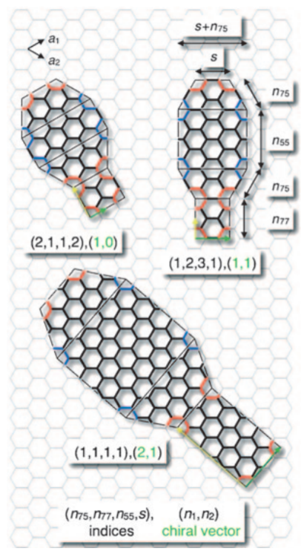
TCNT with pentagons and heptagons
Beuerle, F.; Herrmann, C.; Whalley, A. C.; Valente, C.; Gamburd, A.; Ratner, M. A.; Stoddart, J. F. Chem. Eur. J. 2011, 17, 3868.

Slide 26
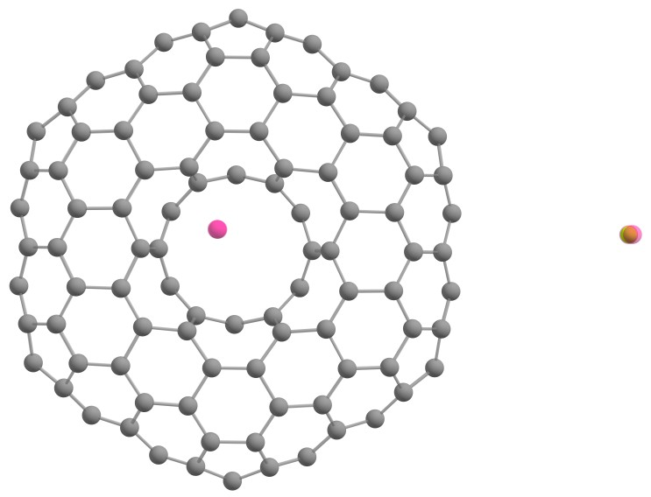
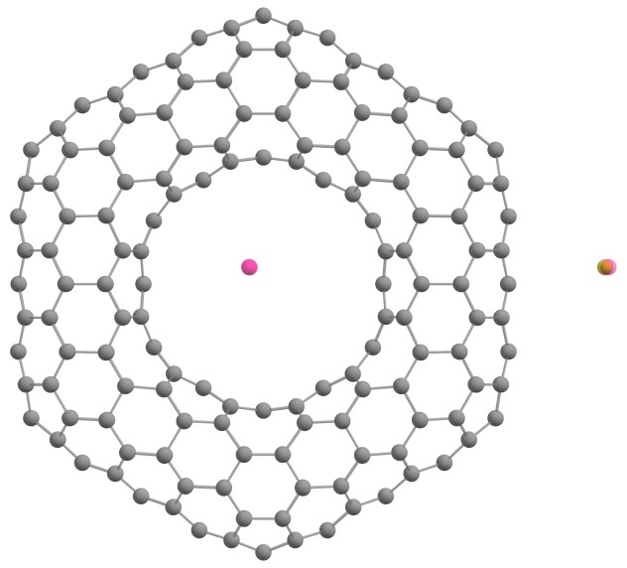
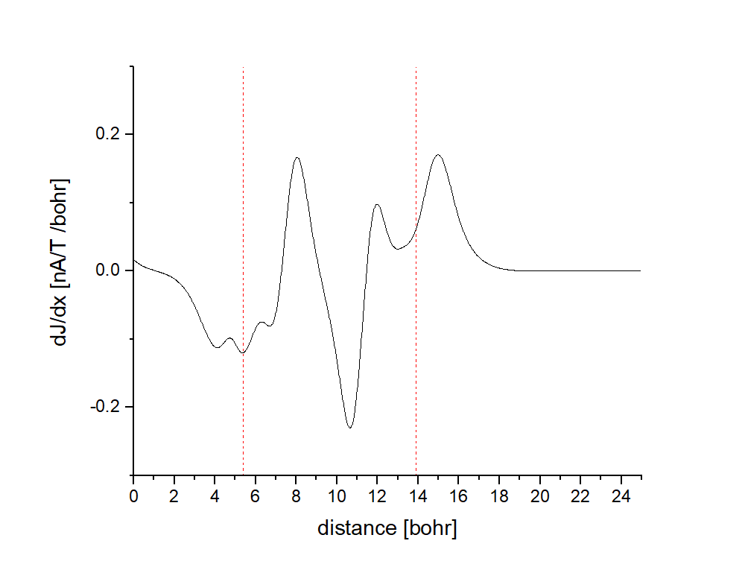
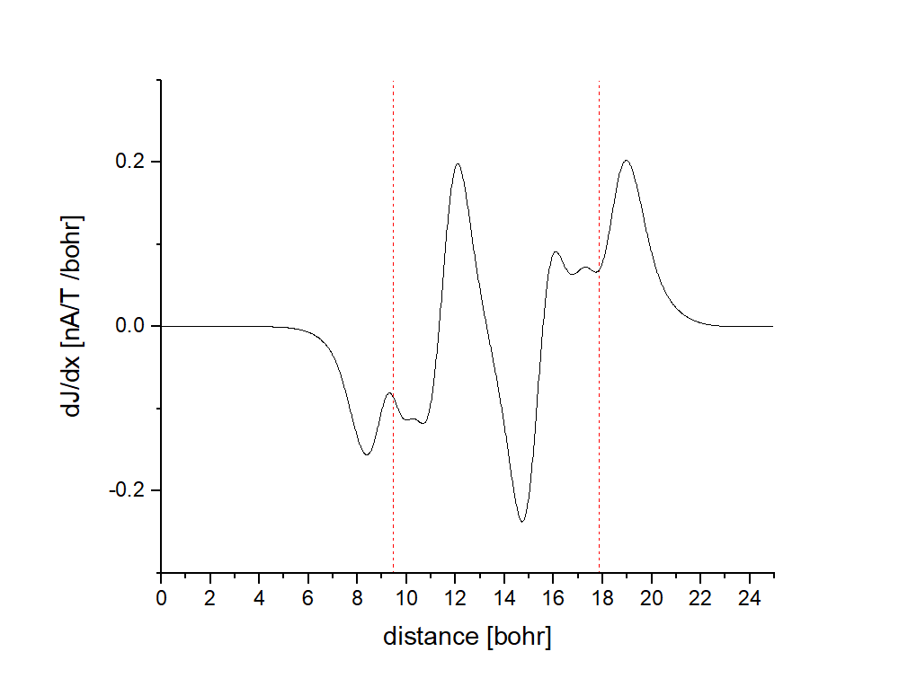

TCNT with pentagons and heptagons
C₁₉₂
C₂₈₈
C₃₈₄
net current: -3.52
net current: -0.57
net current: -2.39

Slide 27


TCNT with pentagons and heptagons
C₂₆₄Si₂₄
net current: -1.82

Slide 28


TCNT with pentagons and heptagons
net current: +1.16

Slide 29









TCNT with pentagons and heptagons
net current: +52.14
net current: +116.55
net current: +169.74

Slide 30

TCNT with pentagons and heptagons
(2n,0) CNT segment
(n,m=n) CNT segment cut at a 30° angle
with respect to the tube axis
Twelve of these joints yield a TCNT:
C₅₇₆
C₄₈₀
B. I. Dunlap, Phys. Rev. B 1992, 46, 1933.

Slide 31


TCNT with pentagons and heptagons
C₄₈₀
net current: +73.70 nA/T
C₅₇₆
net current: +117.84 nA/T

Slide 32




TCNT with pentagons and heptagons
C₄₈₀
C₄₈₀
net current: +73.70 nA/T
net current: -2.45 nA/T
C₅₇₆
C₅₇₆
net current: +117.84 nA/T
net current: +57.72 nA/T

Slide 33

Net currents in TCNT

Slide 34

Net currents in TCNT

Slide 35

Net currents in TCNT

Slide 36

Net currents in TCNT

Slide 37


Net currents in TCNT

Slide 38


Net currents in TCNT

Slide 39

Net currents in TCNT

Slide 40

Energies in TCNT

Slide 41

Functional denpendence

Slide 42

Functional denpendence

Slide 43
Conclusions for TCNT (so far)
a small HOMO-LUMO Gap (< 0.2 eV) is a necessary but insufficient criterion for large net currents
armchair / acene-like Toroidal Carbon Nanotubes are more promissing than zigzag structures
the net current within a given structure type is increasing with increasing tube lenght / circumfence
Most structures have a diatropic net current aromatic
Open questions:
What causes aromatic / antiaromatic net currents?
Are there more specific criteria for the occurrence of large net currents?

Slide 44



Acknowledgement
GIMIC calculations and the toroidal carbon nanotube project
Implementation and general support
Florian Weigend
DFG for funding
Dage Sundholm
Maria Dimitrova
Lukas Wirz
Thank you for your attention!

